Slide 1
Final Project
Alison Schnoes

Slide 2
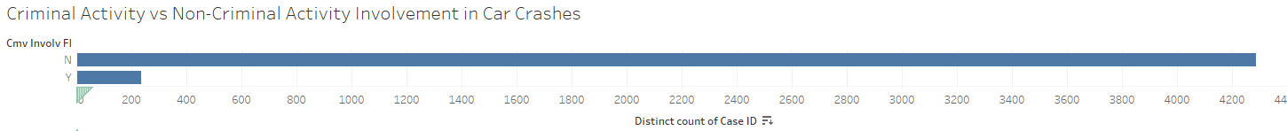
Criminal Activity vs Non-Criminal Activity Involvement in Car Crashes
There are not very many crashes involving criminal activity.

Slide 3
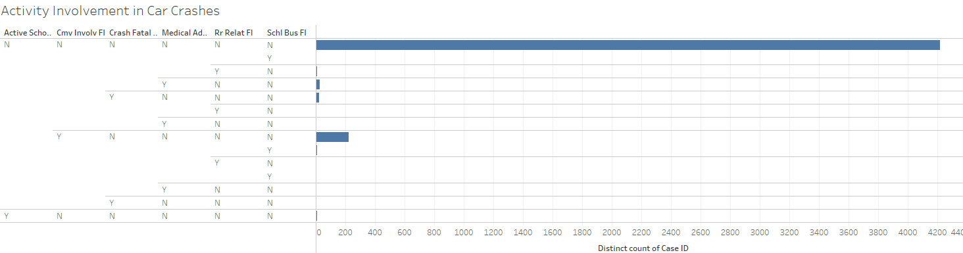
Activity Involvement in Car Crashes
Many car crashes aren’t involved in active shooting, in school bus area, medical areas, crash fatal, and criminal involvement.

Slide 4
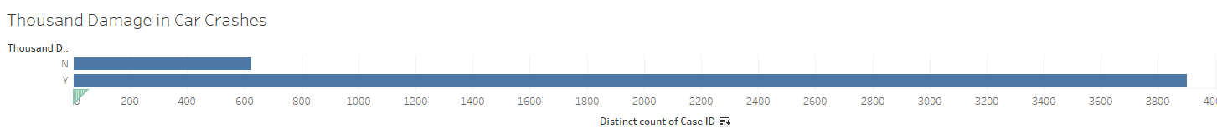
Car Crashes are expensive
Only 13% of car crashes cost less than thousand dollars in damage

Slide 5
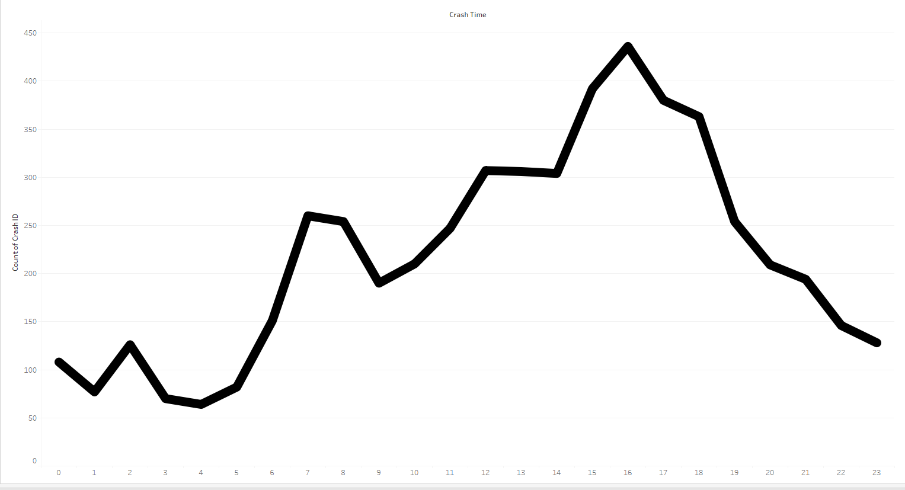
Does time play a factor into car crashes? Yes
The peak time of car crashes is at 16:00 (4pm). The least time of car crashes is at 4am.

Slide 6
Higher Speeds = Fatal Crashes? Avg yes
The faster you are driving the more fatal your crash is on average.

Slide 7
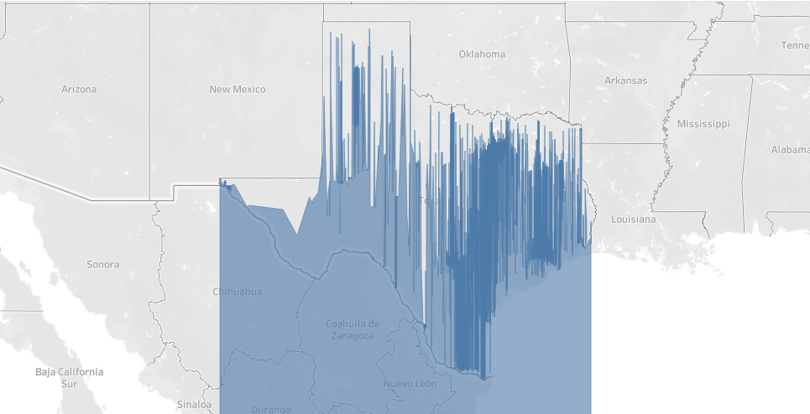
Longitude vs Latitude
We are in the state of TX.

Slide 8
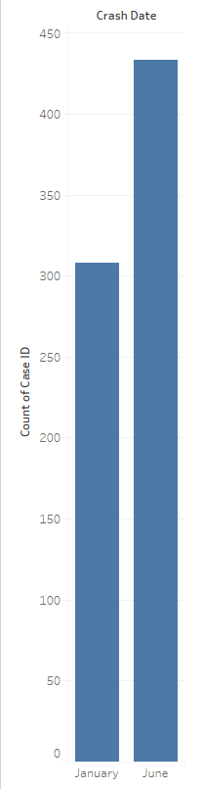
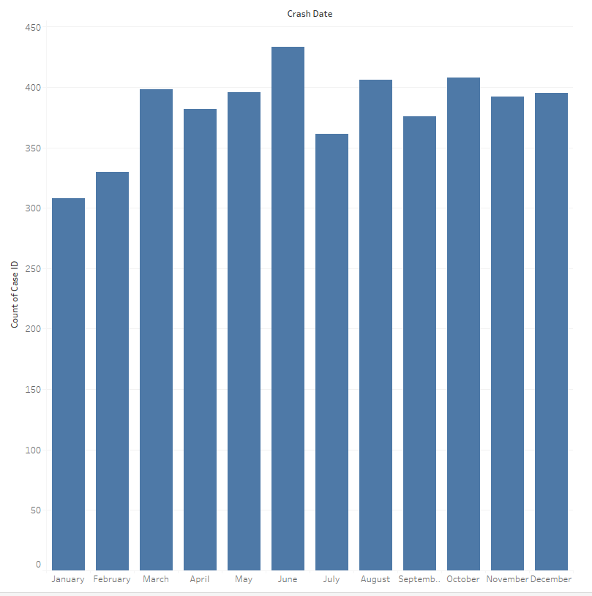
June has the highest crashes, January has the least

Slide 9
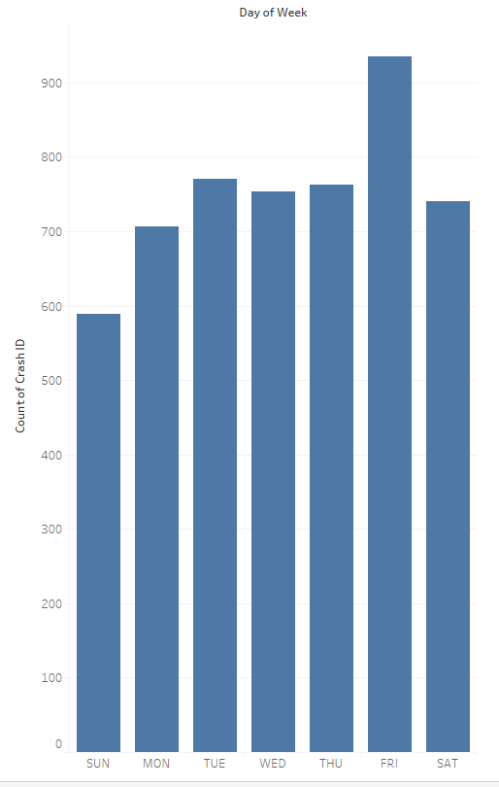
Friday’s have the highest # of crashes while Sunday’s have the least

